Slide 1

Data Science Intern Position Task
Name: Osama Al-Mofti
Date: 30.12.2023

Slide 2
Contents
CRISP-DM MODEL
Business Understanding
Data Understanding
Data Description
Time Meal Analysis
Meal Consumption
Data Preparation & Analysis
Cleaning Process
Description_preprocess
Summary
Categorization
Analysis
Meal Distribution

Slide 3
OVIVA BUSINESS
BUSINESS UNDERSTANDING
DATA UNDERSTANDING
DATA PREPERATION
MODELING
EVALUATION
DEPLOYMENT
empowers to change eating and lifestyle-related habits
partner with health insurers, healthcare systems, NHS, and doctors
combines personalised dietary advice with a unique digital app and provides patients with individual support for targeted dietary changes

Slide 4
SUB TASKS
BUSINESS UNDERSTANDING
DATA UNDERSTANDING
DATA PREPERATION
MODELING
EVALUATION
DEPLOYMENT
Data Description: A brief overview of the data, including its source, variables, and collection process.​
Data Importing: Downloading and loading data into Python environment using Pandas.​
Data Exploration: Gaining insights from the dataset after performing exploratory data analysis.​
Data Quality: Evaluating the quality of the dataset based on insights from data exploration.

Slide 5

DATA DESCRIPTION
BUSINESS UNDERSTANDING
DATA UNDERSTANDING
DATA PREPERATION
MODELING
EVALUATION
DEPLOYMENT
Dataset Name: DATA​
​
Dataset contents:​
​
JSON File:​
Number of rows (724)​
Number of columns (3)
10 unique users ID
Date and time
Description of the meal​

Slide 6
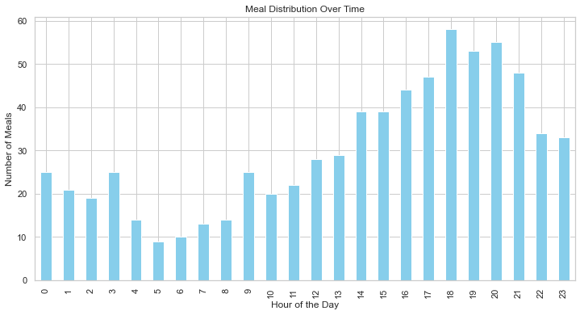
TIME HOUR – MEAL ANALYSIS
BUSINESS UNDERSTANDING
DATA UNDERSTANDING
DATA PREPERATION
MODELING
EVALUATION
DEPLOYMENT
The peak hour for meal distribution aligns with dinner time, occurring at 18:00.
Users tend to consume meals post-work, emphasizing the significance of dinner in their daily eating patterns.

Slide 7
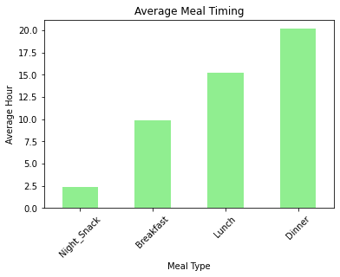
AVG TIME – MEAL ANALYSIS
BUSINESS UNDERSTANDING
DATA UNDERSTANDING
DATA PREPERATION
MODELING
EVALUATION
DEPLOYMENT
Breakfast avg time 10:00
Lunch avg time 15:00
Dinner avg time 20:00
Night_snack avg time 02:30
Our goal is to discourage late-night snacking, considering its potential impact on users’ eating habits.

Slide 8
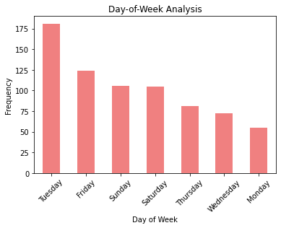
TIME (DAY) - Meal Logging Insights:
BUSINESS UNDERSTANDING
DATA UNDERSTANDING
DATA PREPERATION
MODELING
EVALUATION
DEPLOYMENT
Tuesday Top day with 181 meal loggings.
Friday 2nd highest with 124 meal loggings.

Slide 9
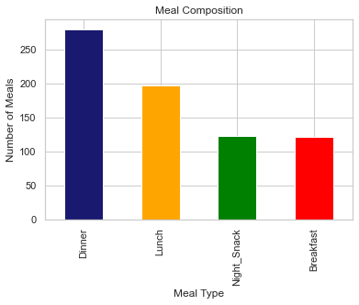
MEAL CONSUMPTION
BUSINESS UNDERSTANDING
DATA UNDERSTANDING
DATA PREPERATION
MODELING
EVALUATION
DEPLOYMENT
Dinner : Top logged meal, totaling 281 entries.
Lunch: 198 entries.
Night Snack: 123 entries.
Breakfast: 122 entries.
Dinner's high frequency highlights its crucial role. Also our objective is to discourage late-night snacking for healthier choices.

Slide 10
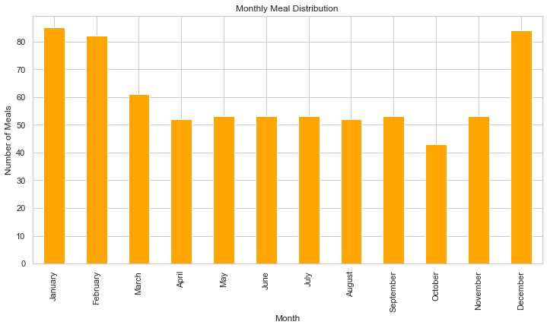
MONTHLY MEAL DISTRIBUTION
BUSINESS UNDERSTANDING
DATA UNDERSTANDING
DATA PREPERATION
MODELING
EVALUATION
DEPLOYMENT
users consume the highest meals in winter seasons December-Feb in an AVG of 80 meals per month

Slide 11
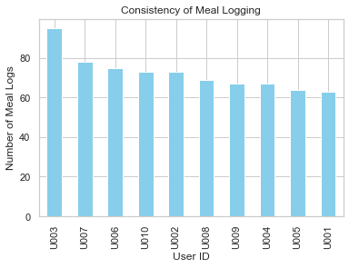
CONSISTENCY OF MEAL LOGGING
BUSINESS UNDERSTANDING
DATA UNDERSTANDING
DATA PREPERATION
MODELING
EVALUATION
DEPLOYMENT
U003 leads with 95 meal loggings, followed by U007 (78) and U006 (75).
User 003 Maybe an old User for OVIVA
High Meals= More Data = Old User

Slide 12
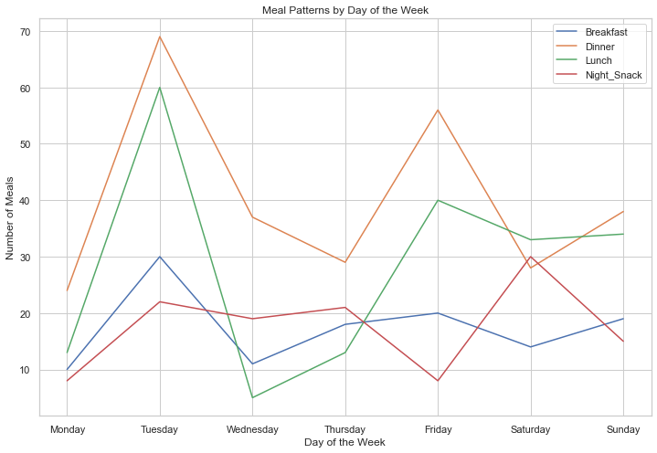
MEAL PATTERN BY DAY
BUSINESS UNDERSTANDING
DATA UNDERSTANDING
DATA PREPERATION
MODELING
EVALUATION
DEPLOYMENT
Tuesday Peaks: Consider offering specials on Tuesdays, especially for lunch and dinner.
Friday Uptick: Weekends show increased meal consumption, likely due to users dining out with family and friends towards the end of the week.

Slide 13
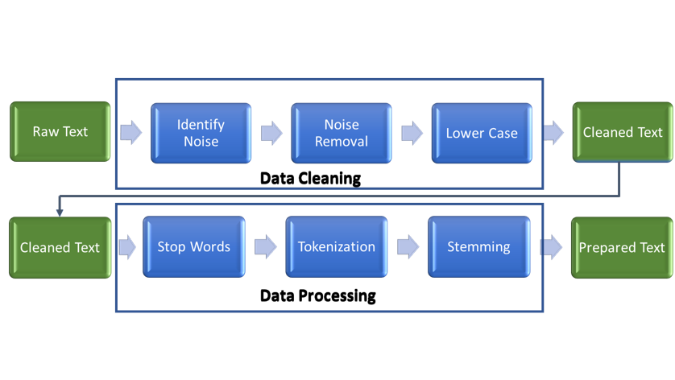
“DESCRIPTION” CLEANING PROCESS
BUSINESS UNDERSTANDING
DATA UNDERSTANDING
DATA PREPERATION
MODELING
EVALUATION
DEPLOYMENT

Slide 14
DATA CLEANING
BUSINESS UNDERSTANDING
DATA UNDERSTANDING
DATA PREPERATION
MODELING
EVALUATION
DEPLOYMENT
Zero missing values in the dataset
Zero outliers
Zero full duplicated row (time,user and description)
Description column is clean, no symbols or other charachters
Total Number of words in description column 7018

Slide 15
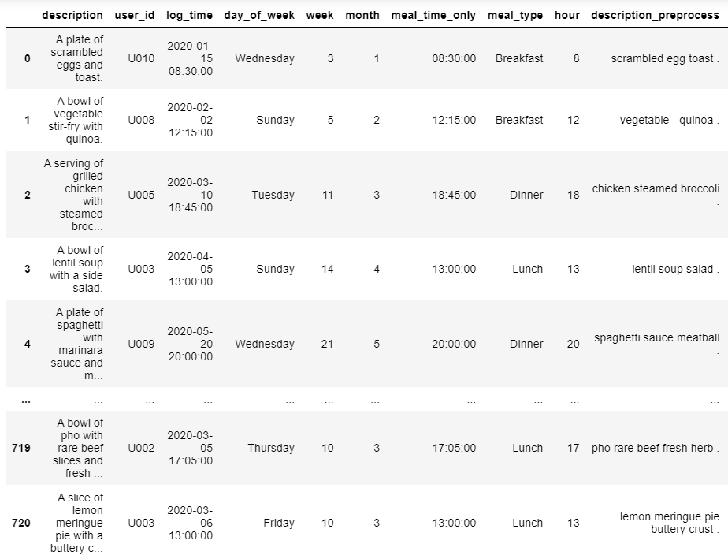
DESCRIPTION COLUMN PREPROCESS
BUSINESS UNDERSTANDING
DATA UNDERSTANDING
DATA PREPERATION
MODELING
EVALUATION
DEPLOYMENT
STOPWORDS
TOKENIZATION
Reason: Improves Focus towards meaningful data
Advantage: Reduce the dataset size and increases efficiency of the model
Reason: Breaking text into tokens helping algorithms understand the structure better.
Advantage: Simplification, Flexibility and C

Slide 16
HOW TO HANDLE 100K LOGGING MEALS
BUSINESS UNDERSTANDING
DATA UNDERSTANDING
DATA PREPERATION
MODELING
EVALUATION
DEPLOYMENT
TF-IDF Vectorizer weights for each word across all meals
Outsoarce labeled dataset for food classification, removing none food related words
WHO, Kaggle

Slide 17
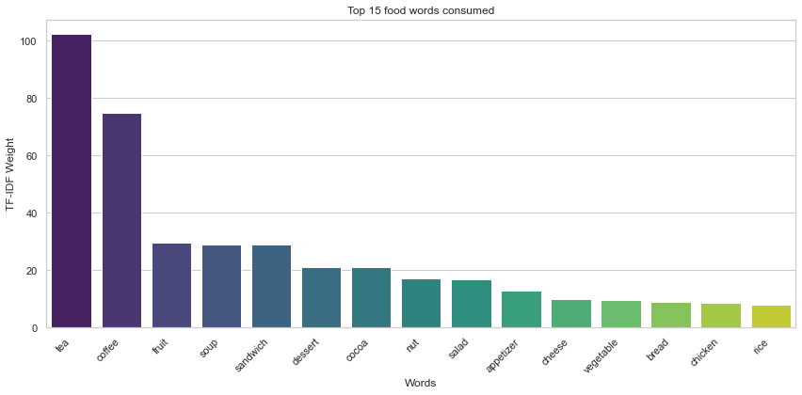
TOP FOOD (WORDS)
BUSINESS UNDERSTANDING
DATA UNDERSTANDING
DATA PREPERATION
MODELING
EVALUATION
DEPLOYMENT
Top 5 Food Items:
Tea (102.31)
Coffee (74.81)
Fruit (29.60)
Soup (29.06)
Sandwich (28.96)
Key Insights: Tea dominates, followed by a preference for coffee and a focus on healthy choices with fruit.

Slide 18
Categorization
BUSINESS UNDERSTANDING
DATA UNDERSTANDING
DATA PREPERATION
MODELING
EVALUATION
DEPLOYMENT
Drinks and Soups
Sugar and Sweets
Meat
Rice, Noodles, and Breads
Grains
Vegetables and Salads
Fruits
Dairy
Nuts

Slide 19
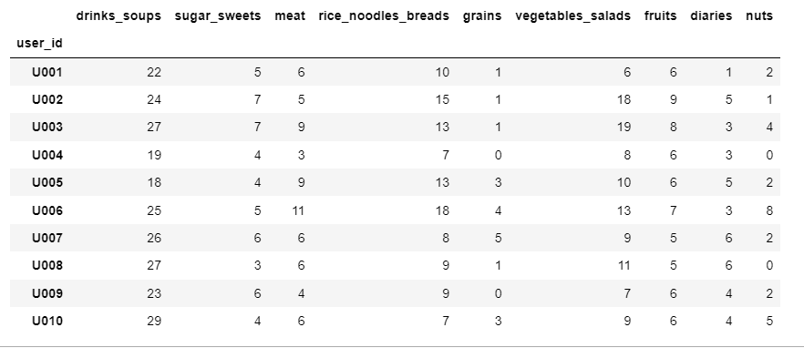
Categorization
BUSINESS UNDERSTANDING
DATA UNDERSTANDING
DATA PREPERATION
MODELING
EVALUATION
DEPLOYMENT
Meal Categories Distribution:
Drinks and Soups: 240
Sugar and Sweets: 51
Meat: 65
Rice, Noodles, and Breads: 109
Grains: 19
Vegetables and Salads: 110
Fruits: 64
Dairy: 40
Nuts: 26

Slide 20
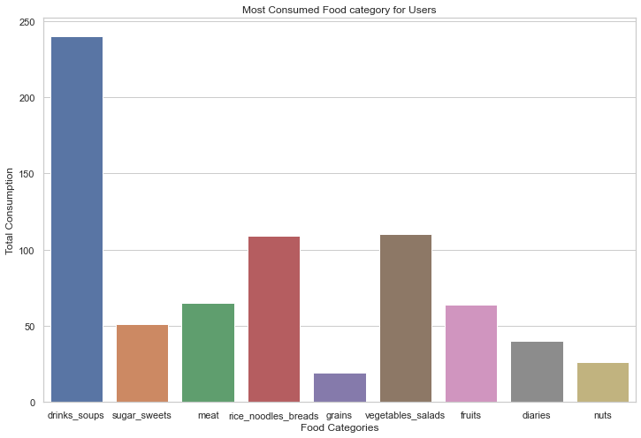
MOST CONSUMED FOOD CATEGORIES
BUSINESS UNDERSTANDING
DATA UNDERSTANDING
DATA PREPERATION
MODELING
EVALUATION
DEPLOYMENT
Top 3 consumed food
Drinks and Soups: 240
Vegetables and Salads: 110
Rice, Noodles, and Breads: 109

Slide 21
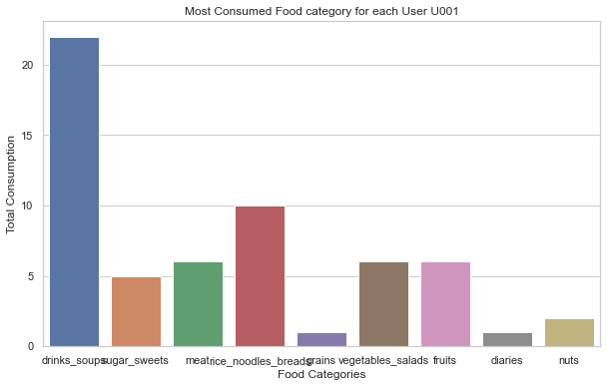
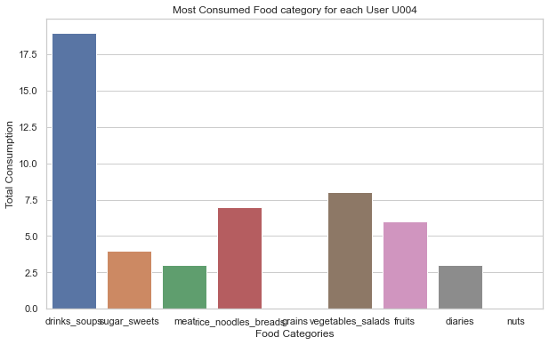
TOP CONSUMED FOOD CATEGORY FOR EACH USER
BUSINESS UNDERSTANDING
DATA UNDERSTANDING
DATA PREPERATION
MODELING
EVALUATION
DEPLOYMENT
Drinks_soups top food category for all users
Users 001,005,006 and 009 consume (rice_noodles_bread) as the highest in food categories (after drinks_soups)
Users 002,003,004,007,008 and 0010 consume vegetables_salads as the highest in food categories (after drinks_soups)
*Regarding space limitation please refer to Python notebook for all visualizations

Slide 22
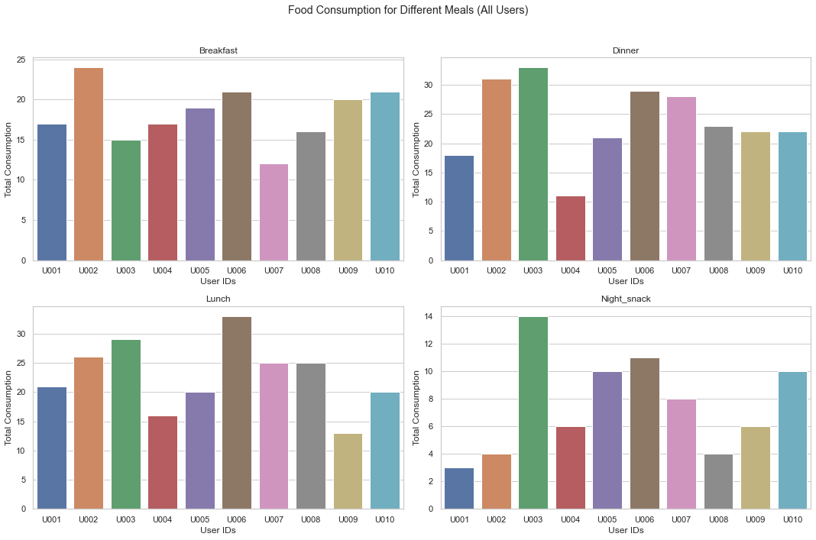
FOOD CONSUMPTION FOR EACH MEAL TYPE FOR USERS
BUSINESS UNDERSTANDING
DATA UNDERSTANDING
DATA PREPERATION
MODELING
EVALUATION
DEPLOYMENT
User 003 has the highest night_snack meals (14) and dinner meals (32) (not healthy)
User 001 least night_snack meals (2) healthier than other users
User 002 highest breakfast meals (24)
User 006 highest lunch meals (34)

Slide 23
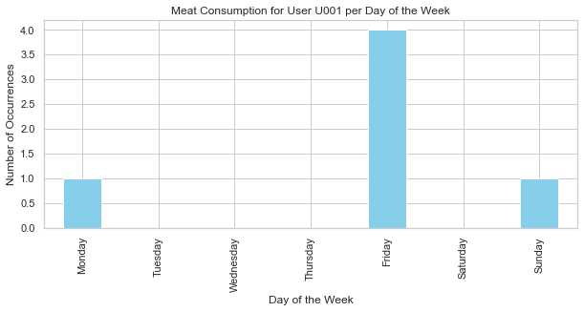
MEAT FOOD CATEGORY ANALYSIS... VEGETERIAN USERS ?
BUSINESS UNDERSTANDING
DATA UNDERSTANDING
DATA PREPERATION
MODELING
EVALUATION
DEPLOYMENT
No vegetarian users
user 001 should distribute meat meals on other days not on friday only

Slide 24
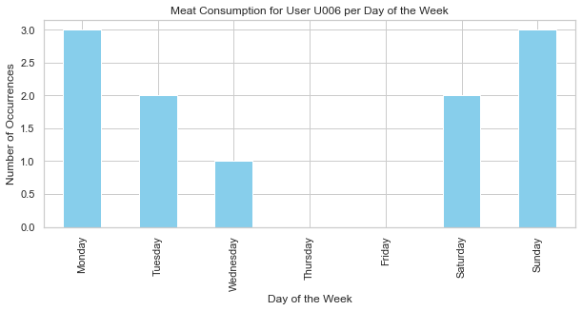
MEAT FOOD CATEGORY ANALYSIS... VEGETERIAN USERS ?
BUSINESS UNDERSTANDING
DATA UNDERSTANDING
DATA PREPERATION
MODELING
EVALUATION
DEPLOYMENT
No vegetarian users
user 006 is top user in meat consumption food_category (11 meals)
User 004 is the least user in meat consumption food_category (3 meals)

Slide 25
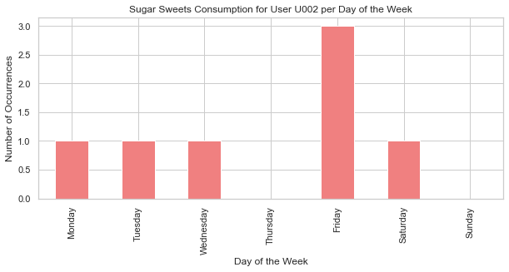
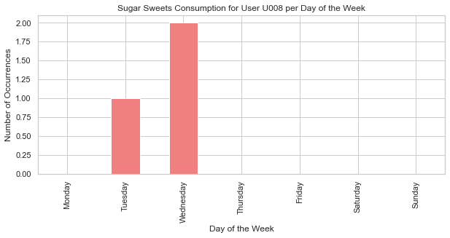
SUGAR_SWEETS ANALYSIS FOR EACH USER IN DAYS
BUSINESS UNDERSTANDING
DATA UNDERSTANDING
DATA PREPERATION
MODELING
EVALUATION
DEPLOYMENT
User 008 is the healthiest user with 3 sugar_sweets meal
User 002 highest Sugar_sweet consumption with 7 meals.

Slide 26
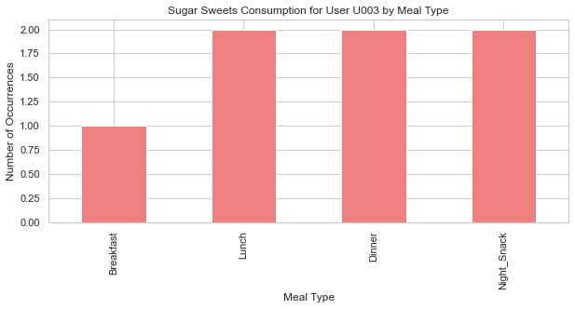
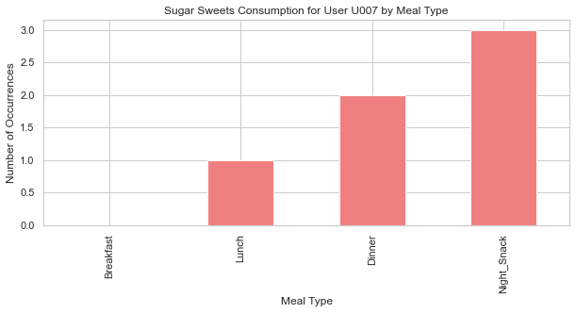
SUGAR_SWEETS ANALYSIS FOR EACH USER PER MEAL
BUSINESS UNDERSTANDING
DATA UNDERSTANDING
DATA PREPERATION
MODELING
EVALUATION
DEPLOYMENT
Users 007 has a bad habit by consuming Sugar_sweets on night snacks
User 003 has also bad habit by consuming Sugar_sweets in every meal.

Slide 27
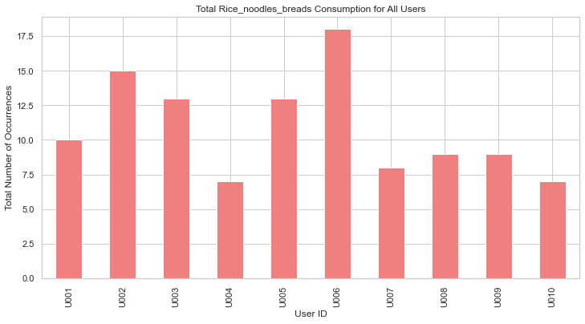
RICE_NOODLES_BREADS ANALYSIS FOR EACH USER
BUSINESS UNDERSTANDING
DATA UNDERSTANDING
DATA PREPERATION
MODELING
EVALUATION
DEPLOYMENT
User 006 consume the highest carbs meals (18)
User 004 the least with nearly (7) meals

Slide 28
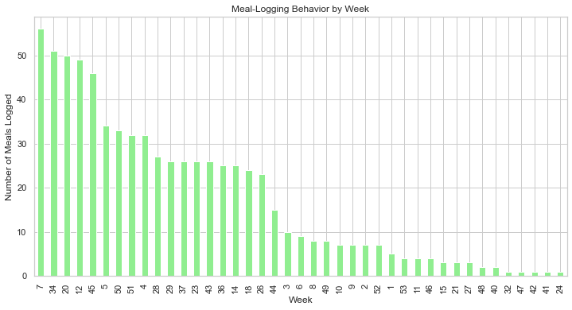
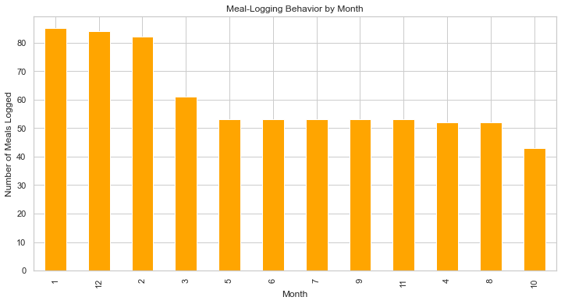
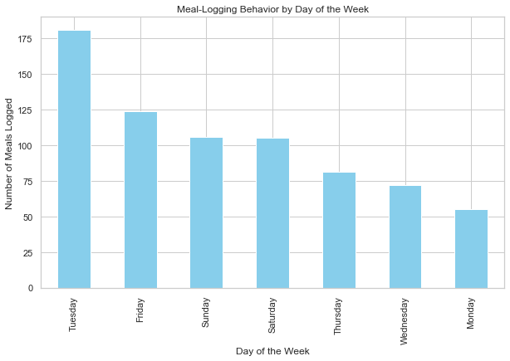
MEAL LOGGING TEMPORAL TRENDS DAILY/ WEAKLY/ MONTHLY
BUSINESS UNDERSTANDING
DATA UNDERSTANDING
DATA PREPERATION
MODELING
EVALUATION
DEPLOYMENT

Slide 29
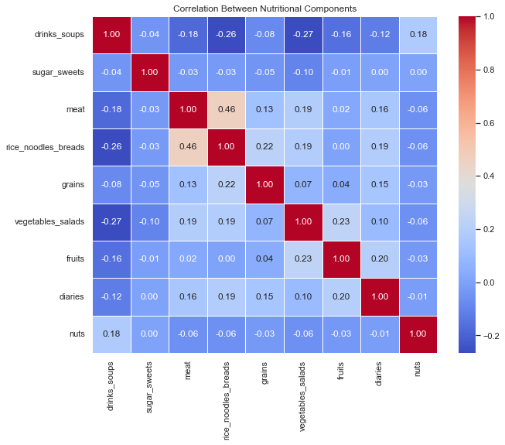
NUTRITIONAL ANALYSIS BETWEEN FOOD CATEGORIES CORRELATIONS
BUSINESS UNDERSTANDING
DATA UNDERSTANDING
DATA PREPERATION
MODELING
EVALUATION
DEPLOYMENT
Highest correlation in food_categories between meat and (rice_noodles_bread) 0.46 (medium good correlation)

Slide 30
SUMMARY
1)User Demographics:
Dataset consists of 10 unique users.
User 003 leads with 95 meals, indicating prolonged engagement.
2)Meal Trends:
123 night_snack meals noted; recommending cessation for all users.
Focus on reducing dinner (281) and increasing breakfast consumption.
3)Top Food Preferences:
Tea, coffee, and fruits rank highest.
Dominant food categories: drinks_soups (240), vegetables_salad (110), rice_noodles_bread (109).
4)User-Specific Observations:
User 003 exhibits unhealthy habits with 14 night_snack meals and 32 dinner meals.
User 001 maintains a healthier profile with minimal night_snack meals (2).
5)Meal Composition:
User 002 tops breakfast meals (24), while user 006 leads in lunch meals (34).
User 006 has the highest carb meals (18), while user 004 has the lowest (6).
6)Cautions and Recommendations:
Users 003 and 007 show a pattern of consuming Sugar_sweets during night_snacks.
User 008 showcases a healthier habit with only 3 sugar_sweets meals compared to the highest, user 002, with 8 meals.
No vegetarian users detected in the dataset.
7)Meal Patterns and Marketing Opportunities:
Peak logging meals on Tuesday (181) suggests potential for promotional offers.
Fridays and weekends show increased meal consumption, likely influenced by social outings.
8)Seasonal and Correlation Insights:
Winter seasons (December-Feb) witness the highest meal consumption.
A moderate correlation (0.46) observed between meat and rice_noodles_bread categories.

Slide 31
VIELEN DANK

